Slide 1
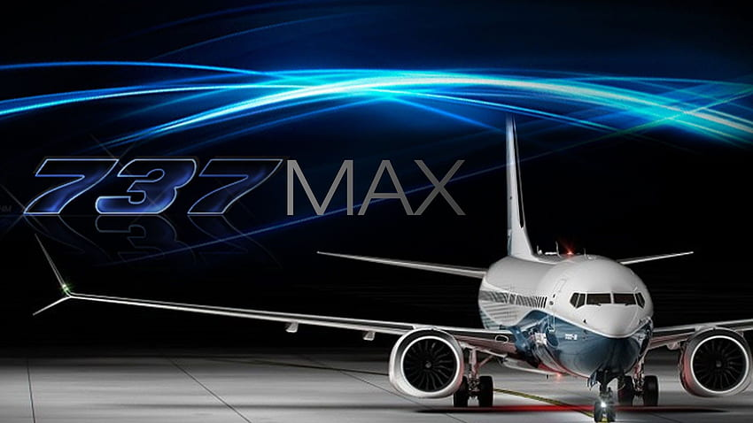
UNRAVELING THE BOEING 737 MAX SOFTWARE DEBACLE
Group : 21

Slide 2
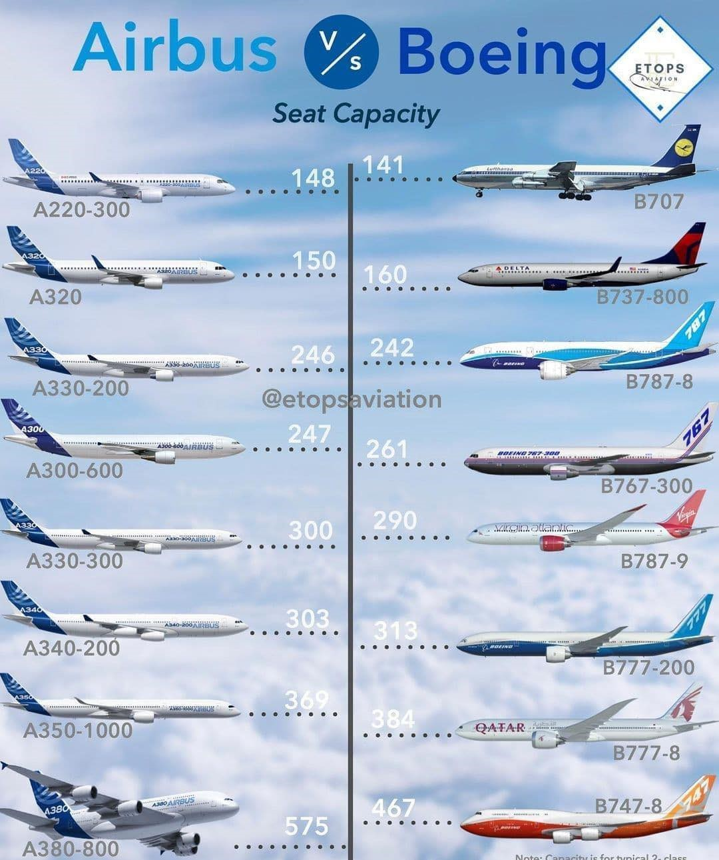

Slide 3
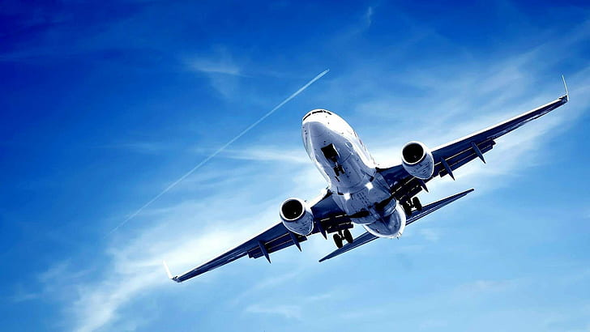
INTRODUCTION
Boeing introduced the 737 Max 8 in August 2011 as the latest version of the popular 737 series, aiming to replace the 737 Next Generation.
The 737 Max gained acclaim for features such as quieter engines, reduced operating costs, and improved fuel efficiency, making it Boeing's flagship aircraft with orders from over 50 global airlines.
Tragic crashes in Ethiopia and Indonesia in 2019, attributed to a malfunctioning sensor and automated system issues, raised significant safety concerns about the 737 Max.
Boeing faced criticism for allegedly prioritizing profit over safety, leading to widespread cancellations and reductions in orders from airlines around the world.
Initially defending the 737 Max, Boeing later accepted full responsibility for the incidents. CEO David Muilenburg expressed regret and committed to addressing the issues.

Slide 4

PROBLEM STATEMENT
The Boeing 737 Max crash case study aims to investigate the root causes and contributing factors behind the accidents of Lion Air Flight JT610 and Ethiopian Airlines Flight ET302. The study will focus on the role of Maneuver Characteristics Augmentation System (MCAS) software in accidents. The goal is to provide insights into the complex interplay of these factors, facilitating lessons learned for the improvement of aviation safety.

Slide 5
MAJOR EXTERNAL FACTORS
The Flight Path Patterns and Crash Causes
Angle of Attack (A.O.A.) Sensors
Collaboration with Civil Aviation Authorities
Financial Repercussions

Slide 6
MINOR EXTERNAL FACTORS
Boeing's Public Communication Strategies
Orders and Cancellations from Airlines
Stock Market Reactions
Industry Testing Results
Shareholder Proposals

Slide 7
MAJOR INTERNAL FACTORS
Cultural Shift Post-Merger
Impact on Values
Focus on Cost-Cutting
Organizational Resistance

Slide 8
MINOR INTERNAL FACTORS
Ineffective Communication
Automated Controls Issue
Unjustified Cost Savings
Importance of Internal Collaboration

Slide 9
SOLUTIONS
All flight control systems, including the Maneuver Characteristics Augmentation System (MCAS), should undergo thorough testing.
Provide pilots flying the 737 MAX with extensive training programs that are developed and implemented.
Examine the 737 MAX's aerodynamics thoroughly to find design changes that could improve stability and avoid dangerous flying situations.
Increase transparency in communications between the public, regulatory bodies, Boeing, and airline passengers.
Reassess the corporate culture at Boeing, prioritizing a safety-first approach over competitive pressures and financial considerations.
Regularly conduct internal and external safety audits to identify and address potential risks before they escalate.

Slide 10
